Slide 1
Altrincham Football Club
Strategic Review
Pete Foster, Nicky Watmore
26 February 2017

Slide 2
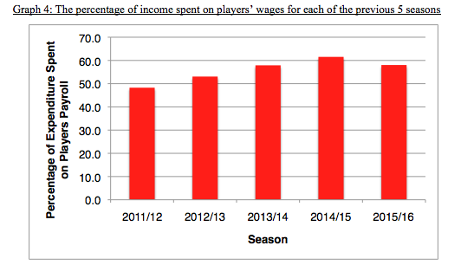
A Mistake

Slide 3
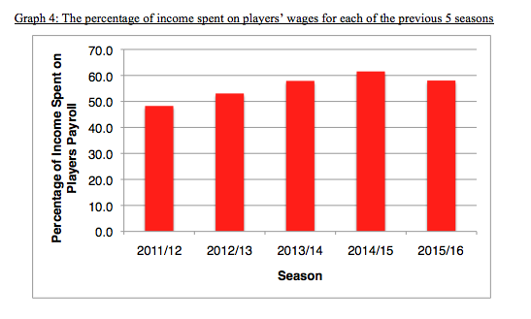
Correction

Slide 4
Strategic Review – Background
Around 100 Interviews/Questionnaires/Surveys
Fans, Sponsors, Directors, Players, Volunteers
Lots of different views, many common themes, some diametrically opposed
Lots of ideas and suggestions
Thank you to all who contributed

Slide 5
Strengths/Opportunities
Financially the football club is seen by most to be very well run
Community Sports Hall and Stadium Improvements are widely seen as a big success, contributing to the fanbase and circa £60K per annum directly to Club funds
The ethos of the Club - volunteer led, family-friendly feel, loyal fanbase, community oriented, proud history etc - is what the vast majority of stakeholders like about the Club and wish to maintain
While some would like to aim for League 2, most believe it is a realistic ambition to be a safe, National League club within the next five years
AltyTV, Radio Robins and social media presence
The Club’s ladies and junior set-up is strong, although the potential to exploit these links remains largely untapped
With no debt and an eighty year lease on a ground in an affluent area, the Club has every opportunity to survive and go from strength to strength over the long term

Slide 6
Weaknesses/Threats
Performance on the pitch over recent seasons has not matched financial expenditure on the team
Performance on the pitch this year has plumbed new depths. Consequently there has been a loss of player connection with, and passion for, the Club
The Board lacks structure, perceives itself to be weak and divided, and most others have lost confidence in the Board as a collective, whilst recognising the prodigious efforts which individuals expend on the Club’s behalf
The quality, not the amount, of communications and PR between supporters and the Club is failing.
The Club lacks diversity in many of its ways of operating and its “look and feel”
Throughout the entire club there can be seen to be a reluctance to accept new ideas and a lack of ambition
There is a general lack of forward planning (beyond one year) evident throughout the entire club. As a consequence:
The ground as a whole is starting to feel tired
Inadequate succession planning has threatened the sustainability of the volunteer model
Current commercial model of the Club may have reached its maximum results
Club website is valued for its content but needs modernising with a major technology refresh

Slide 7
Where there are different views
Diffuse ownership, self reliance
Sell to an investor
Embed the club in the heart of the community for the good of the football
Focus on the community has meant football affairs have suffered with catastrophic results
This survey has been a welcome opportunity to air my views
This survey has been boycotted by the (angry) majority of fans
Family-friendly feel of the Club is what attracts me
The Club is very cliquey and I feel excluded

Slide 8
HOWEVER, ON BALANCE THE VIEW IS
Don’t chase the ‘local Abramovich’ - but do use the existing structure to tap into the wealth of the area for strategic investment
The football and community focus go hand in glove, but the priority focus should be, and crucially be seen to be, on the football with stronger football leadership and capability on the Board
There is a minority of fans that are angry, who nonetheless care about the club and so should not be ignored. However, we believe even they can be won over with the right actions
A more inclusive, diverse and meritocratic approach to selecting Board members and volunteers and interacting with stakeholders more generally is necessary to overcome the sense of cliqueiness

Slide 9
And so….
(based on the information provided)
Don’t throw the baby out with the bathwater. Restate the essence of the Club according to its key principles:
Football first (prioritising men’s 1st team, but also with further development of women’s/junior teams)
A history and ethos to be proud of
Financially sound - short and long term
Volunteer led club, part-time playing model
Strong and growing links to the local community
Innovation (e.g. CSH, AltyTV/RR/social media)
Stability over the long term

Slide 10
And so…. (based on the information provided)
Restore the on-field success of the men’s 1st team
Refresh the Board
Re-establish stakeholder relations
Develop a management structure below board level and conduct sustained volunteer recruitment drive
Develop, publish, implement and report against a five year plan for the Club
Put in place a programme of diversity and inclusion

Slide 11
Strategic Review – Closing Remarks
At times of stress many issues come to a head, this is evident at the Club now
If results had been ok, we would not be here giving this presentation. However that does not mean we should not be here, many issues would have been present irrelevant of results
It is now up to the board to decide how to react to the content and consider the Club’s next steps

Slide 12
Altrincham Football Club Strategic Review
Thank you

